Slide 1
Terraform 10 1
Infinity Works 101 Sessions
Tutors : Richard Harper
WiFi : WeWork
Password : P@ssw0rd
Slack : https://tinyurl.com/yar2yfpb
https://github.com/RichardHarperInfinityWorks/100-training-terraform

Slide 2
Why are we doing this ?
To spread the knowledge of what we are doing
To improve by teaching
To involve more people with what we are excited about
Offer something different to the community
Notes:
This opening session give an overview of the background about Go and a
foundation for building applications. Chapter 1 starts with an overview of Go for
those not already familiar with it.
Chapters 2 and 3 move into base components for an application. Chapter 2
provides the foundation for building an application, including working with
console applications and servers, and handling configuration. Chapter 3 focuses
on using goroutines. Goroutines are one of the more powerful and useful elements
in Go. They’re regularly used in Go applications, and you’ll see them
through the rest of this book.

Slide 3

Terraform-100
Session 1

Slide 4

Agenda
Introduction to Terraform
HCL
Variables
Providers
Data Sources
Resources
Structure of a Terraform Project
Installing Terraform
The Terraform CLI
Getting the sample code
Deploying an server with Terraform - Workshop

Slide 5
An introduction to Terraform
Infrastructure as code

Slide 6

Overview
“Terraform is a tool for building, changing, and versioning infrastructure safely and efficiently.” www.terraform.io
“Terraform generates an execution plan describing what it will do to reach the desired state, and then executes it to build the described infrastructure.” www.terraform.io

Slide 7


Sequence of Deployment
Design
Plan Changes
Apply Changes

Slide 8


State Persistence / Purpose
State location can be defined
Describes known artefacts only
Local state by default
Used to plan against
Updated post apply
Can be manipulated
STATE

Slide 9
HCL (HashiCorp Configuration Language)
HCL is designed to be both human and machine friendly
Single line comments start with # or //
Values are assigned with the syntax key = value # (whitespace doesn't matter).
Values can be any primitive: a string, number, boolean, object, or list.
Strings double-quoted can contain any UTF-8 characters: // “Hello, World”
Interpolated Values can be accessed using ${scope.key} # ${var.myvariable}

Slide 10
Variables
variable "aws_region" {
description = "EC2 Region for the VPC"
default = "eu-west-1"
}
Input variables serve as parameters for a Terraform module, each block declares a single variable, all arguments are optional.
Root Module can be set from CLI arguments & environment variables, child Modules allow values to pass from parent to child.
Type # defines the type of the variable; string, list, & map.
Default # defines a default value for the variable if not set.
Description # should be a human-friendly description for the variable.

Slide 11
Provider Configuration
provider "aws" {
# AWS provider region set in vars
region = "${var.aws_region}"
}
Providers are responsible for understanding API interactions and exposing resources.
Current list of Terraform Providers: https://www.terraform.io/docs/providers/index.html
Current list of Community Providers: https://www.terraform.io/docs/providers/type/community-index.html

Slide 12
Data Source Configuration
data "aws_ami" "amazon-linux-2" {
most_recent = true
filter {
name = "name"
values = ["amzn2-ami-hvm*"]
}
filter {
name = "architecture"
values = ["x86_64"]
}
}
Data sources allow data to be fetched or computed for use elsewhere in Terraform configuration.
Either, Present read-only views OR compute new values
Configuration TYPES are specific to a Provider # AWS in this case
Data instances have a “TYPE” & “NAME” # this combination must be unique
Each exports one or more attributes # accessible by ${data.TYPE.NAME.ATTR}

Slide 13
Resource Configuration
resource "aws_instance" "myinstance" {
ami = "${data.aws_ami.amazon-linux-2.id}"
instance_type = "t2.micro"
tags = {
Name = "myinstance - 101 Training"
}
}
Resources represent components of your infrastructure # Database, DNS record...
Current documentation for all resources can be found online: https://www.terraform.io/docs/providers/aws/r/instance.html
Resources have a “TYPE” & “NAME” # resource “PROVIDER_TYPE” “NAME”
Resources have multiple arguments some of which are [optional]
Values can be dynamic and are wrapped with ${scope.name.property}
Some arguments accept arrays: [x,y,z] or collections: argument = { key = value }

Slide 14
Structure of a Terraform Project
Infrastructure as code

Slide 15
The bare minimum project
richard@groundhog:~$ tree
.
├── aws.tf
├── main.tf
├── README.md
├── terraform.tfvars
└── variables.tf
Terraform will read all *.tf files in a directory
aws.tf # contains the Terraform provider details
main.tf # contains the Terraform resources to plan against
README.md # a guide in Markdown syntax that describes the project/repo
terraform.tfvars # variable values to be available to *.tf as ${var.x}
variables .tf # variable definitions and defaults that can be overridden in terraform.tfvars

Slide 16
Installing Terraform
Infrastructure as code

Slide 17
Installing the Terraform CLI
(Command Line Interface)
Instructions: https://www.terraform.io/downloads.html for: macOS, FreeBSD, Linux, OpenBSD, Solaris & Windows.
To test your installation:
richard@groundhog:~$ terraform --version
Terraform v0.11.11

Slide 18
The Terraform command
Infrastructure as code

Slide 19
Terraform - Command Line Interface
the basics….
init # initialize a Terraform working directory, downloads providers and modules in the *.tf
plan # generate and show an execution plan based upon the state vs design
apply # builds or changes infrastructure, from a resource graph
destroy # destroy Terraform-managed infrastructure

Slide 20
Getting the sample code
Infrastructure as code

Slide 21

Checkout the code using Git
Installing Git https://git-scm.com/downloads for: Mac OS X, Windows & Linux/Unix
To test your Git installation:
Repository: https://github.com/RichardHarperInfinityWorks/100-training-terraform
Git command to clone source code locally:
richard@groundhog:~$ git --version
git version 2.17.1
richard@groundhog:~$ git clone https://github.com/RichardHarperInfinityWorks/100-training-terraform.git

Slide 22


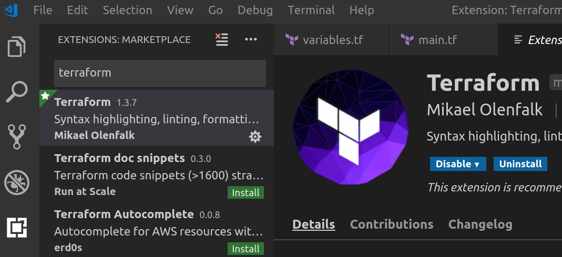
Open the code in VS Code
Download & install VS Code https://code.visualstudio.com/download
For: Mac OS X, Windows & Linux.
Open Folder…
select the location you cloned the repository
Install the Terraform Extension; reload IDE...

Slide 23

Configuring the AWS credentials for Terraform to use
Detailed instructions: https://www.terraform.io/docs/providers/aws/
# Static
provider "aws" {
region = "eu-west-1"
access_key = "anaccesskey"
secret_key = "asecretkey"
}
# Environment Vars
provider "aws" {
}
# Shared Credentials file
provider "aws" {
region = "eu-west-1"
shared_credentials_file = "~/.aws/creds"
profile = "customprofile"
}
richard@groundhog:~$ export AWS_ACCESS_KEY_ID="anaccesskey"
richard@groundhog:~$ export AWS_SECRET_ACCESS_KEY="asecretkey"
richard@groundhog:~$ export AWS_DEFAULT_REGION="us-west-2"

Slide 24
Deploying an EC2 instance with Terraform
Infrastructure as code

Slide 25
www.infinityworks.com

